Slide 1
Linear Models Beyond Straight Lines: Transformations and Linear-in-Parameters Models
Chapter 11
Built from current MLR slides 120-131

Slide 2
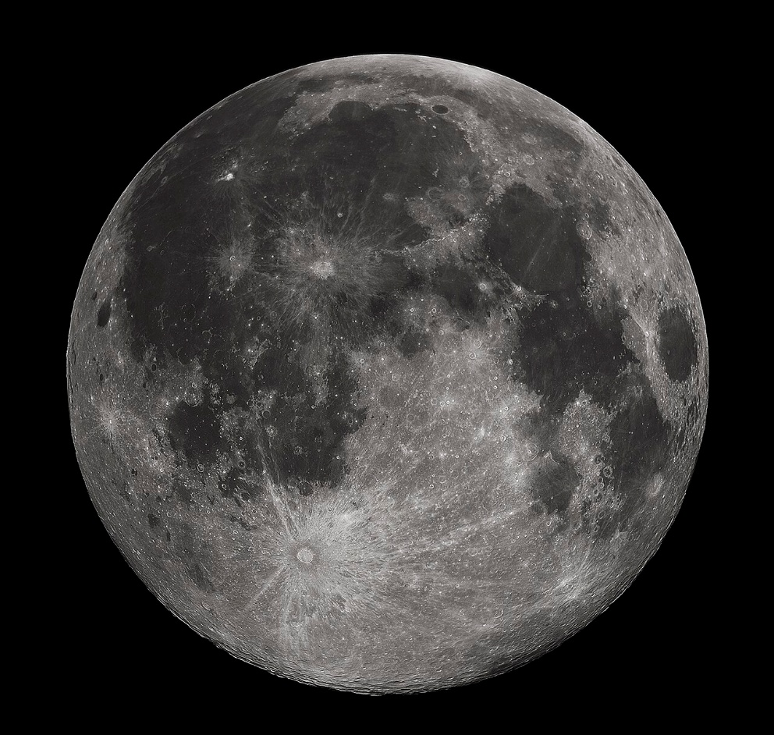
The Moon Motion Problem
The Moon is tidally locked… but not perfectly.
The Moon “wobbles” in three ways:
Longitude
Latitude
Diurnal
So we can actually see approximately 59% of the near side of the moon (vice 50% with a perfect tidal lock.)
By Gregory H. Revera, CC BY-SA 3.0, https://commons.wikimedia.org/w/index.php?curid=11901243

Slide 3
The Moon Motion Problem
Tobias Mayer (1723-1762) collected data to describe this wobbling motion of the moon, libration, as a linear function of two variables.
He collected 27 measurements total, placed into 3 groups of 9 measurements each.
His objective was to solve for the coefficients in the linear function.

Slide 4
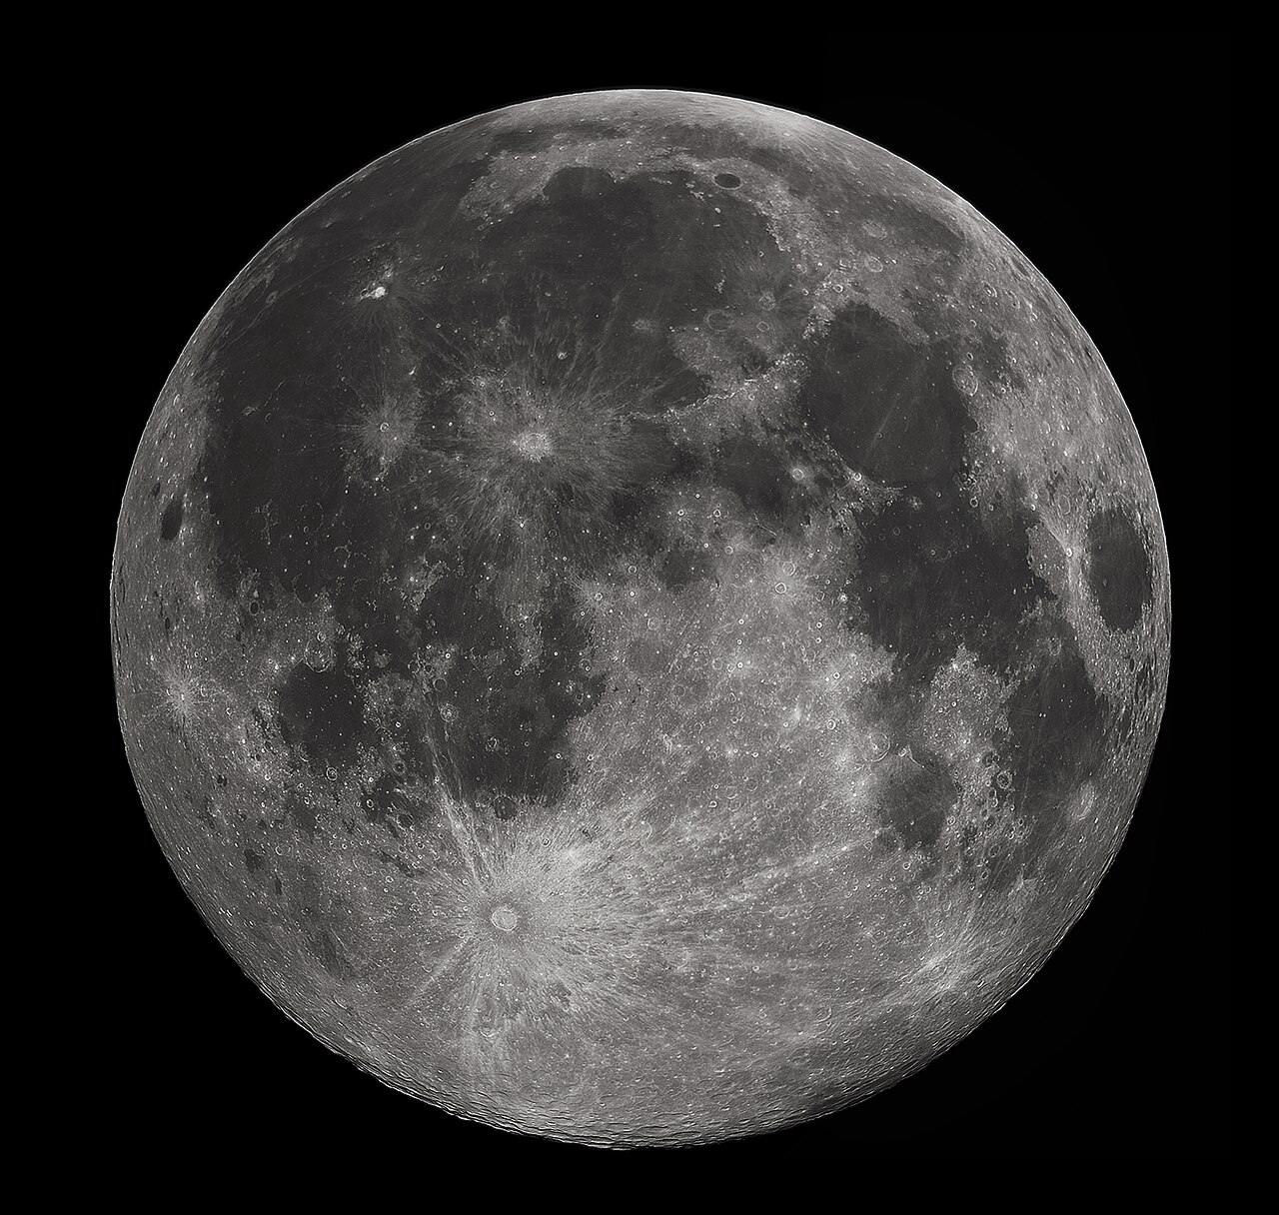
Mayer’s Equation
Given
$Y≔$ arc (libration)
$x_{1}≔sin$of a key angle relative to the Manilius crater
$x_{2}≔\cos{ }$of of a key angle relative to the Manilius crater
$$Y=β+αx_{1}+γx_{2}+ε$$
Objective: Solve for $β, α,$and $γ$.
By Gregory H. Revera, CC BY-SA 3.0, https://commons.wikimedia.org/w/index.php?curid=11901243

Slide 5
Bivariate Model
With two predictors and a single response, we project the arc data $Y$ onto a 2-dimensional plane.
As we expect from an overdetermined set of data, not all 27 points lie on the plane.
Each data point has an associated distance (in the direction of $Y$) from the regression plane.

Slide 6
What Gives?!
This does not look “linear.”
$\sin{θ_{ }}$and $\cos{φ}$ aren’t linear functions
So how do we define linear?

Slide 7
From Linear Algebra
We can define a basis any way we want to*, as long as:
Scalar multiplication behaves properly
Addition behaves properly
Recall the basis is just a set of directions that can uniquely describe every vector in the space.
Ex:
The standard basis.
The polynomial basis.
Therefore, a linear model is one that incorporates a linear relationship among the parameters ${\hat{β}}_{0},{\hat{β}}_{1},…,{\hat{β}}_{p}$, not of $x_{i}$
*I call this a cousin of “You can’t stop me…”

Slide 8
Which of These Models is Linear?
$β_{0}+β_{1}x$
$β_{0}+β_{1}x+β_{2}x^{2}+β_{3}x^{3}$
$β_{0}x^{β_{1}}$
$β_{0}+β_{1}x_{1}+β_{0}β_{1}x_{1}^{2}$
$\frac{1}{β_{0}+β_{1}x}$
$\frac{e^{β_{0}+β_{1}x}}{1+e^{β_{0}+β_{1}x}}$
$β_{1}\sin\left(x\right)+β_{2}\cos\left(x\right)+β_{3}\sin\left(x\right)\cos\left(x\right)$
$β_{0}+β_{1}x_{1}+β_{2}x_{2}+β_{3}x_{1}x_{2}$

Slide 9
How can we tell “at a glance”?
Look at the design matrix $X$ and parameters $\hat{β}$.
Ex: $β_{0}+β_{1}x+β_{2}x^{2}+β_{3}x^{3}$

Slide 10
Design Matrix View
If the model can be written as
$$Y=Xβ+ε$$
it is linear.
Example:
$$X=\left[\begin{matrix}1 & x_{11} & x_{21} & x_{11}x_{21} \\ 1 & x_{12} & x_{22} & x_{12}x_{22} \\ ⋮ & ⋮ & ⋮ & ⋮ \\ 1 & x_{1n} & x_{2n} & x_{1n}x_{2n}\end{matrix}\right] \hat{β}=\left[\begin{matrix}{\hat{β}}_{0} \\ {\hat{β}}_{1} \\ {\hat{β}}_{2} \\ {\hat{β}}_{3}\end{matrix}\right]$$

Slide 11
Mayer’s Equation
Given
$Y≔$ arc (libration)
$x_{1}≔sin$of a key angle relative to the Manilius crater
$x_{2}≔\cos{ }$of of a key angle relative to the Manilius crater
$$Y=β+αx_{1}+γx_{2}+ε$$
Objective: Solve for $β, α,$and $γ$.
By Gregory H. Revera, CC BY-SA 3.0, https://commons.wikimedia.org/w/index.php?curid=11901243

Slide 12
Transformations
This gives us a powerful tool for fitting our data to more realistic models.
$$Y=β+αx_{1}+γx_{2}+ε$$
$Y≔$ arc
$x_{1}≔sin θ$
$x_{2}≔\cos{φ }$

Slide 13
Better Fitting Models
This opens up many more possibilities of modeling the relationship of our data with a linear model.
We can examine the residual behavior from our Truth+Error discussion to help us decide what a “better” model is.

